Slide 1

Azure Machine Learning
Vani Mandava
Microsoft Research Outreach
@vanimt
Notes:
Add Microsoft research logo on each slide

Slide 2
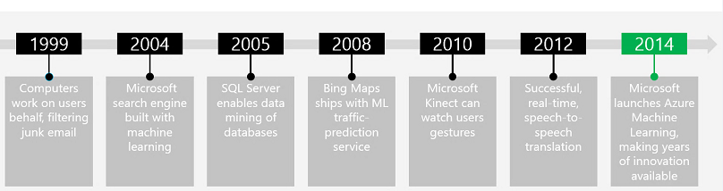


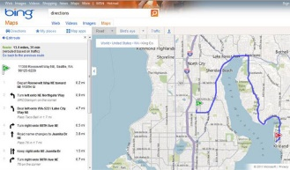
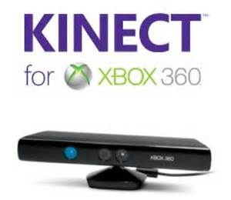



Microsoft Machine Learning
Modified from - http://www.pulsweb.fr/predict-wine-quality-azureml/

Slide 3
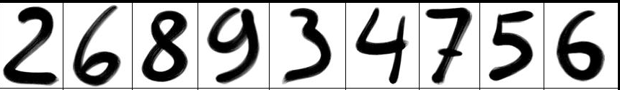

Quick lesson on supervised learning
Accuracy = 100%
Accuracy = 50%
2 6 8 9 3 4 7 5 6
Train -> Score
Evaluate
Score
Publish
5 1
5 6
Model

Slide 4
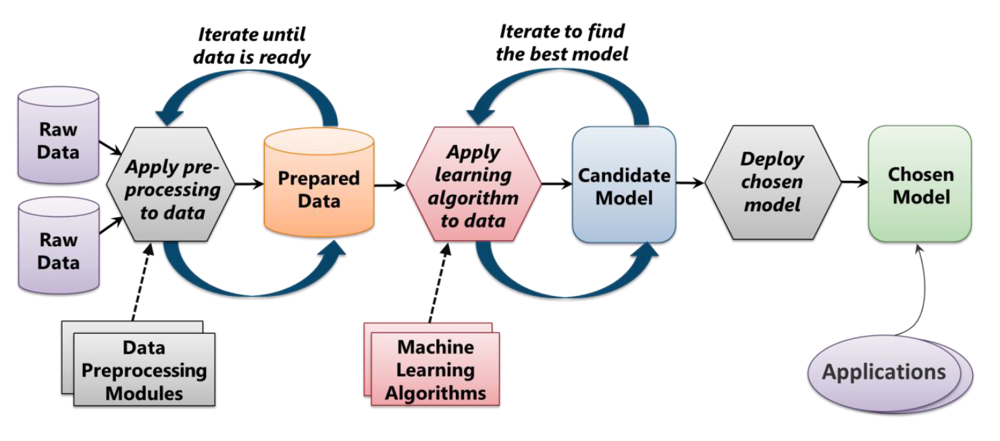
Machine Learning Process
From Introduction to Microsoft Azure - David Chappell

Slide 5
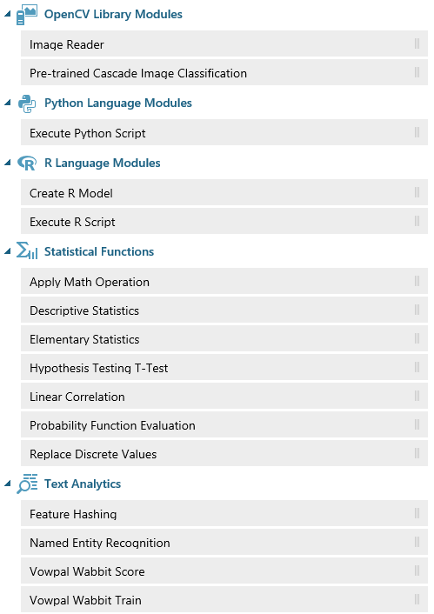
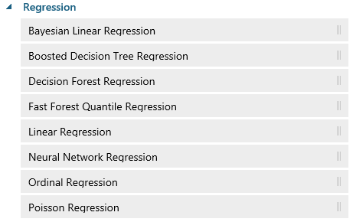
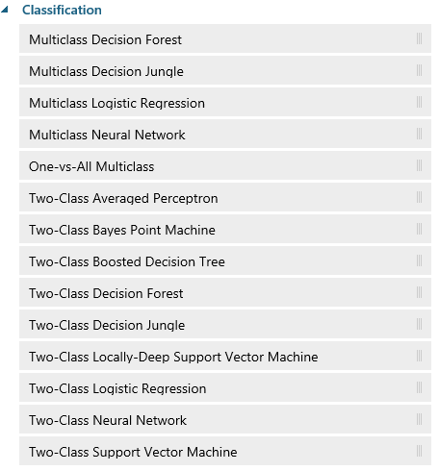
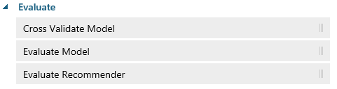
Sample of algorithms available

Slide 6
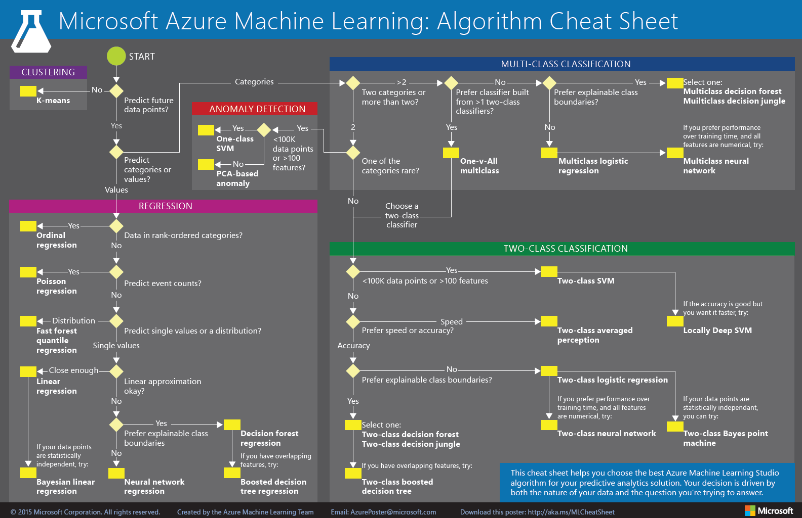
http://aka.ms/MLCheatSheet

Slide 7
Hands on Lab

Slide 8
Cloud based machine learning
Try Azure Machine Learning for free (no credit card or subscription required)
https://studio.azureml.net/Home

Slide 9
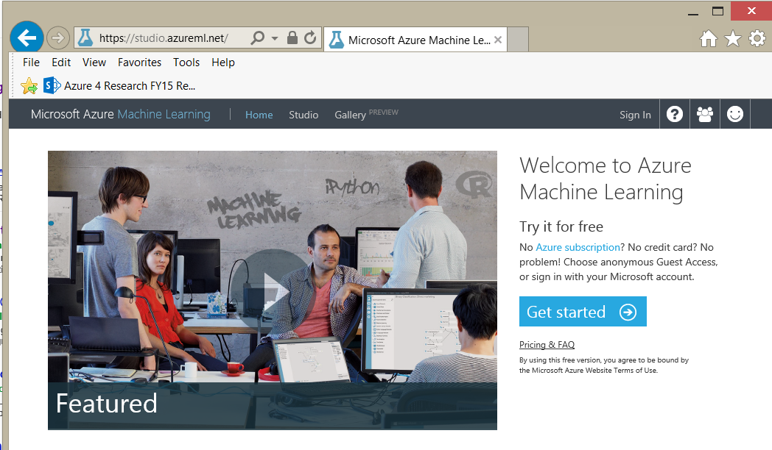

Slide 10
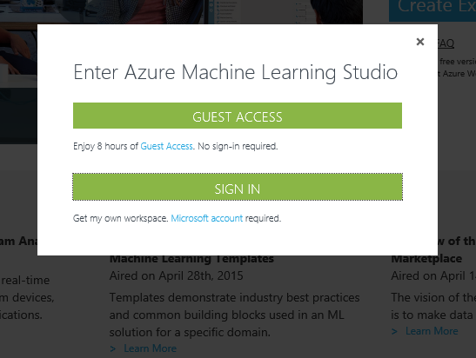
Guest Access

Slide 11
Problem
Predict the price of an automobile given a dataset of known automobile prices

Slide 12
5 Steps to create an experiment
Create a model
Step 1: Get data
Step 2: Preprocess data
Step 3: Define features
Train the model
Step 4: Choose and apply a learning algorithm
Score and test the model
Step 5: Predict new automobile prices

Slide 13
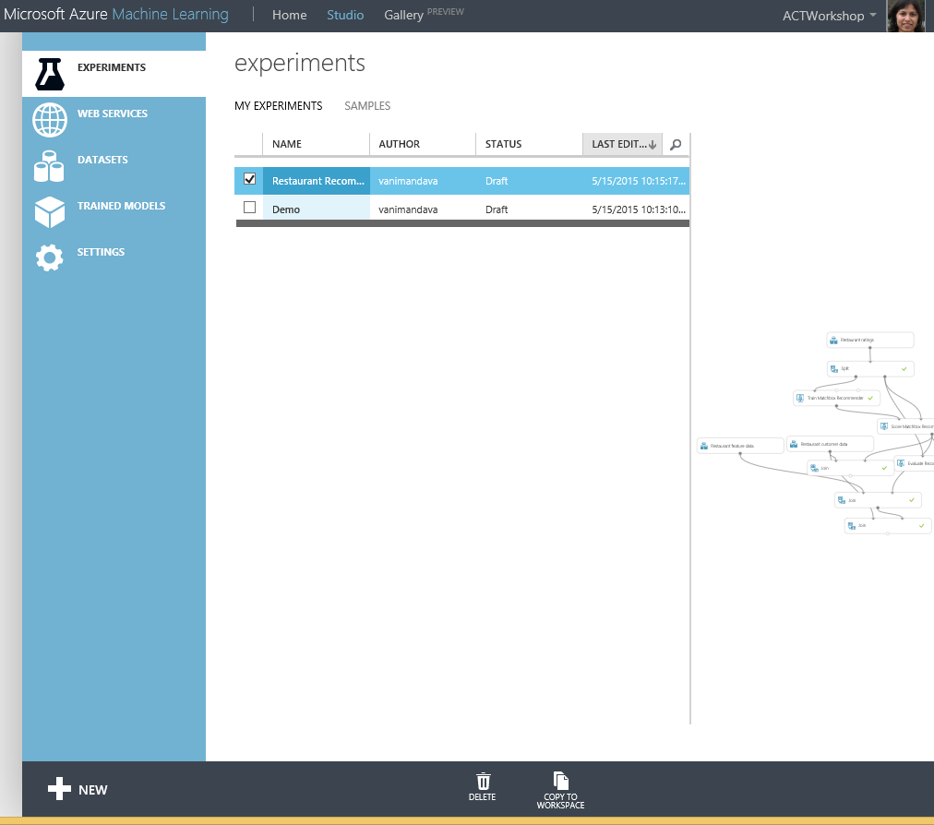

Slide 14
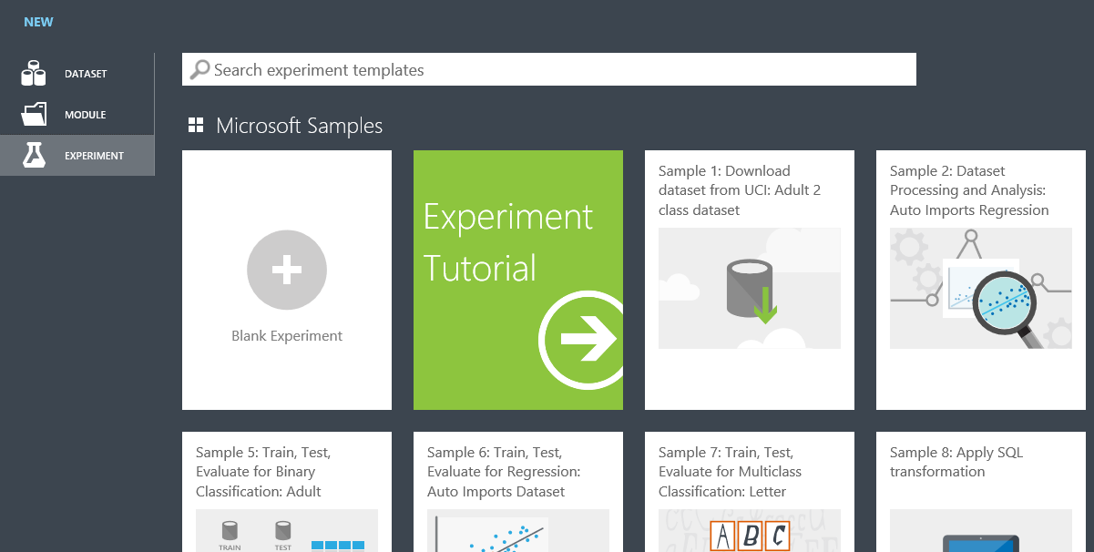

Slide 15
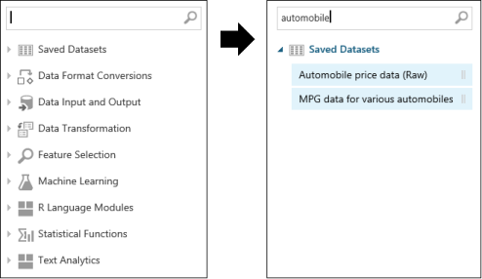

Slide 16
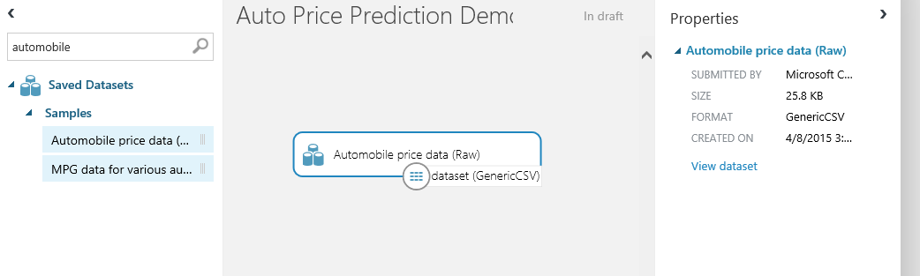

Slide 17
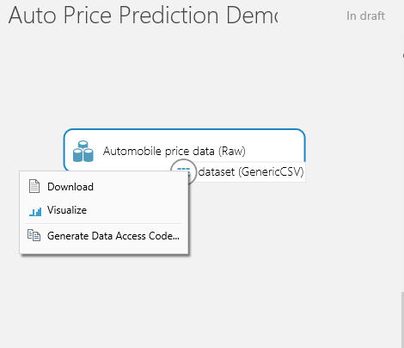

Slide 18
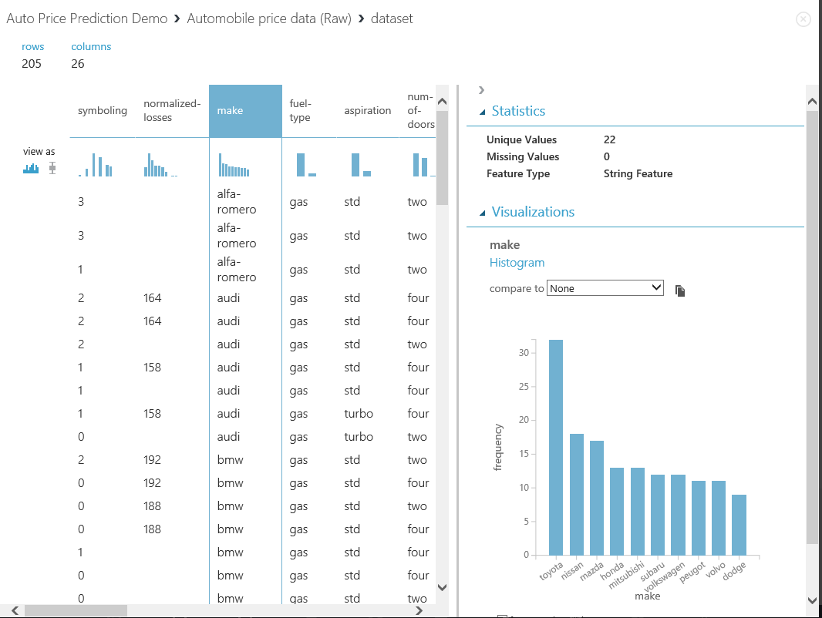

Slide 19
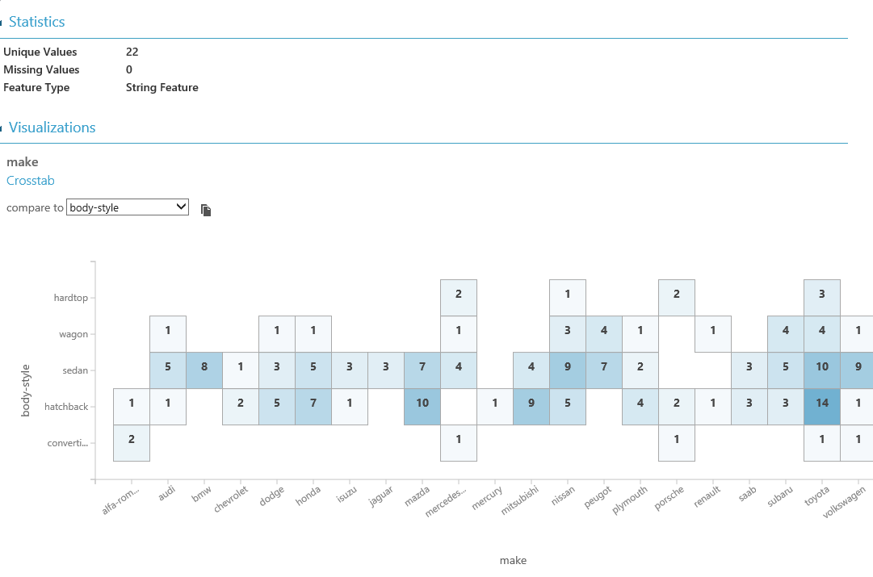

Slide 20
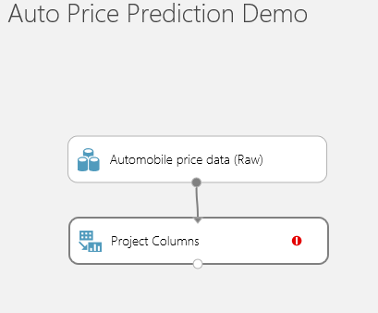
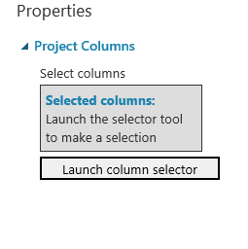
Project Columns

Slide 21
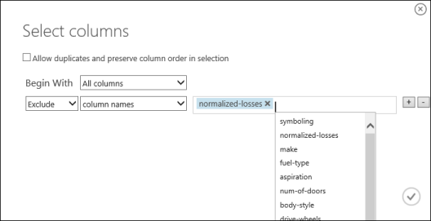
Project Columns

Slide 22
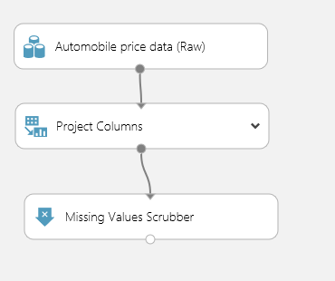
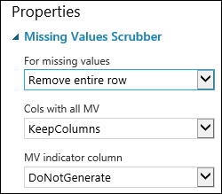
Missing Values Scrubber

Slide 23
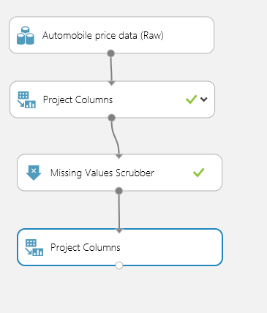
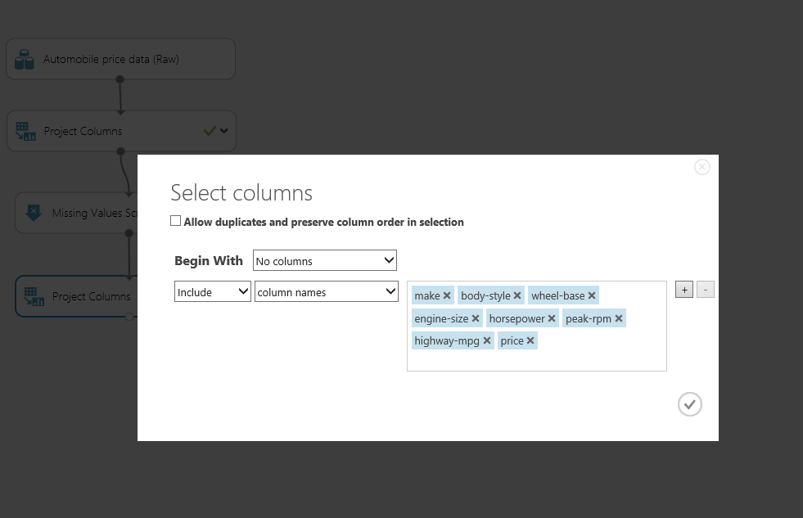
Define Features

Slide 24
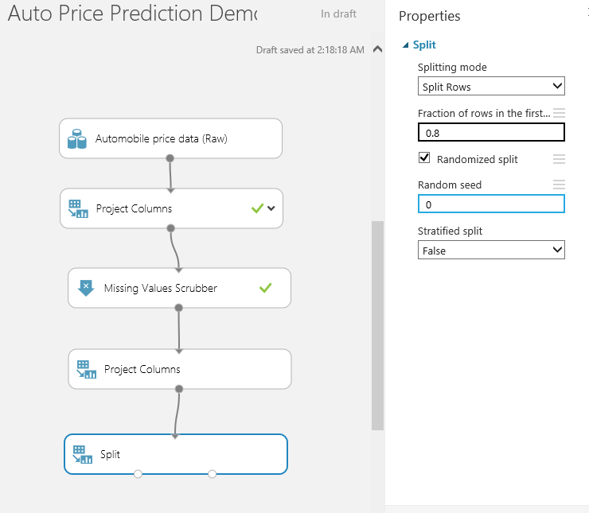
Split Training and Testing Data

Slide 25
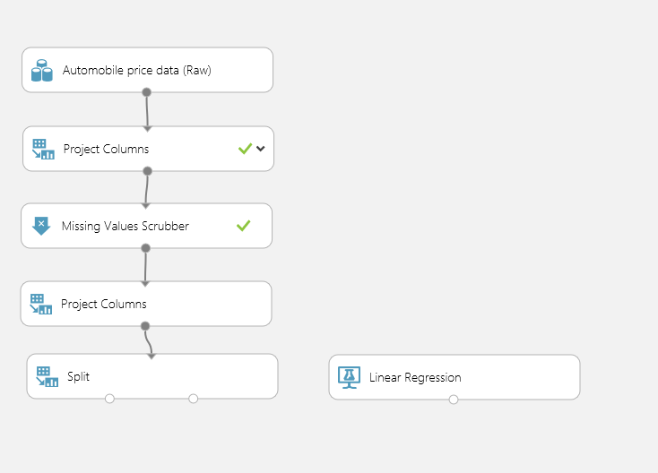
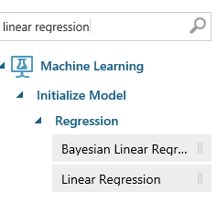
Choose ML algorithm

Slide 26
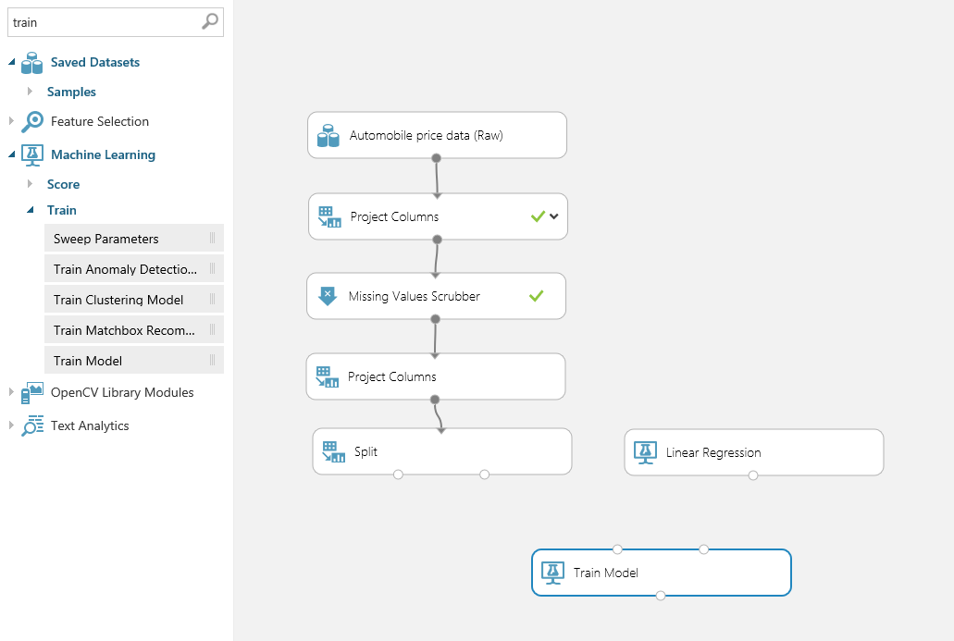
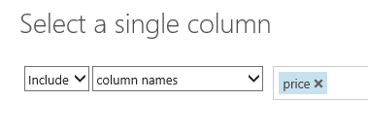
Select prediction parameter at Train module

Slide 27
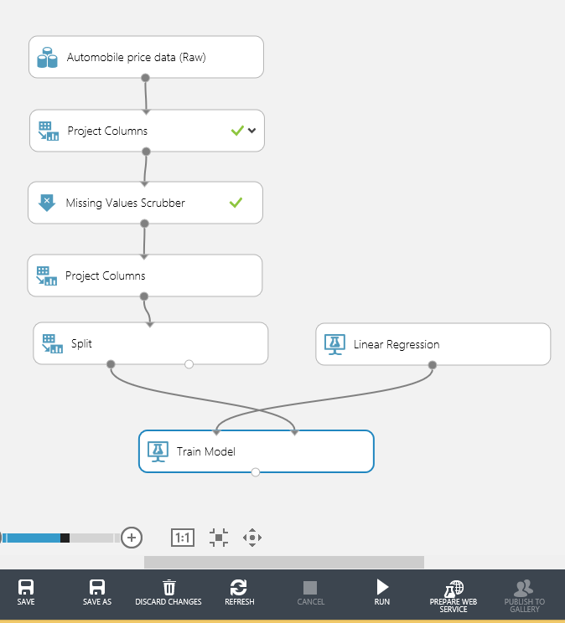
Connect and run the training

Slide 28
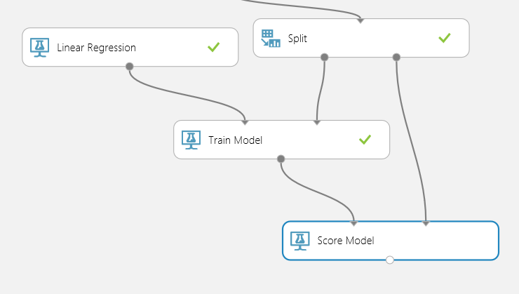
Connect and Score the model
20% test data

Slide 29
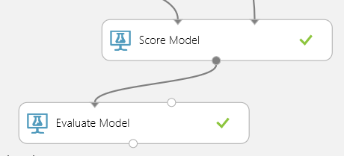
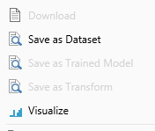
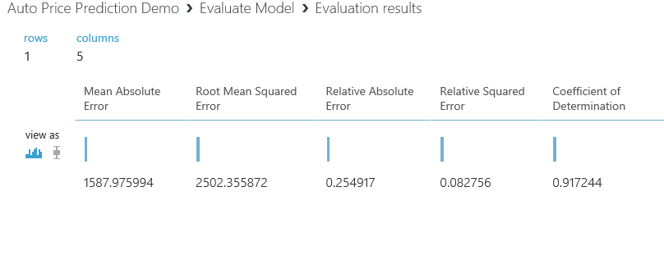
Evaluate Model

Slide 30
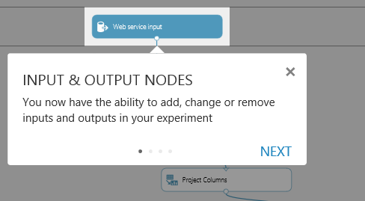
Publish as Web Service

Slide 31
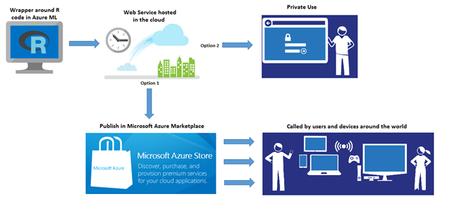
Azure ML
http://azure.microsoft.com/en-us/documentation/articles/machine-learning-r-csharp-web-service-examples/

Slide 32

Azure for Research
Notes:
Add azure for research logo here.

Slide 33
Azure for Research Request for Proposals
Affiliated with a university or non-profit lab
Proposals should be up to 3 pages
Proposals should include resource usage requirements (# of cores, storage etc)
Award is valid for one year
Size of the allocation is substantial and suitable for significant research project

Slide 34
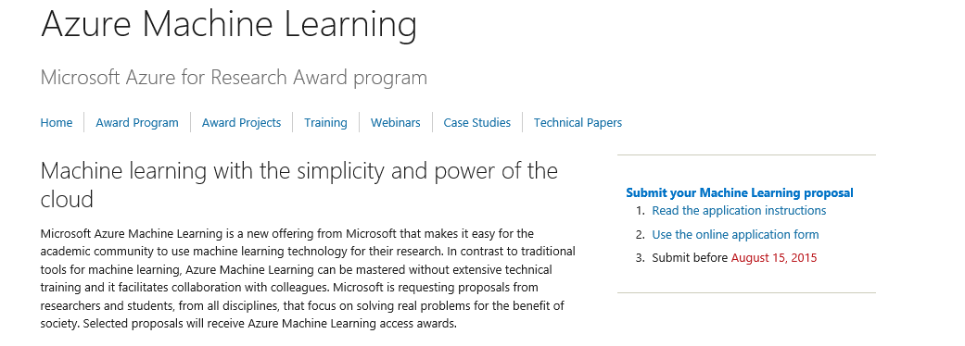
Azure ML for Research
Azure4Research.com -> Award Program -> Azure Machine Learning
http://research.microsoft.com/en-us/projects/azure/ml.aspx

Slide 35
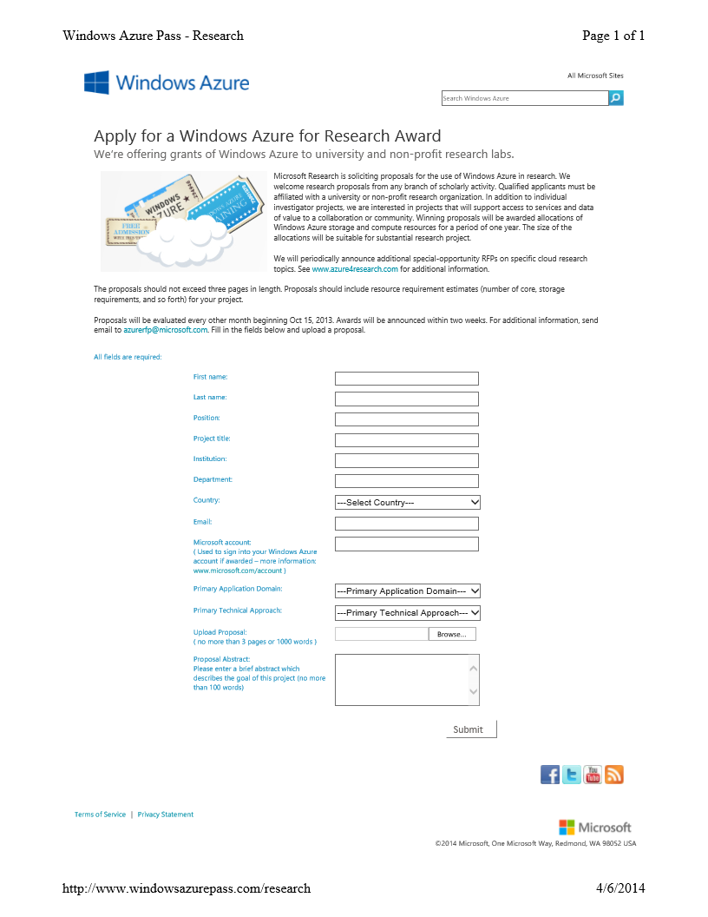

Slide 36
Thank You
vanim@microsoft.com

